Slide 1
Data analyst vesna cari
EmporiUm Bookstore Sales Analysis

Slide 2
Territory overview
Territory 1: South Carolina
Territory Manager: Len Jensen
Region: South
Region Director: Andy Gisselquist
Total Stores: 2
Stores:
Store 852—Charleston
Store 853—Greenville
Territory 2: New York
Territory Manager: See Ellefson
Region: East
Region Director: Ana Jilani
Total Stores: 12
Stores:
Store 840—Albany
Store 841—Buffalo
Store 947—Rochester
Store 849—Brooklyn
Store 850—New York City
+7 more

Slide 3



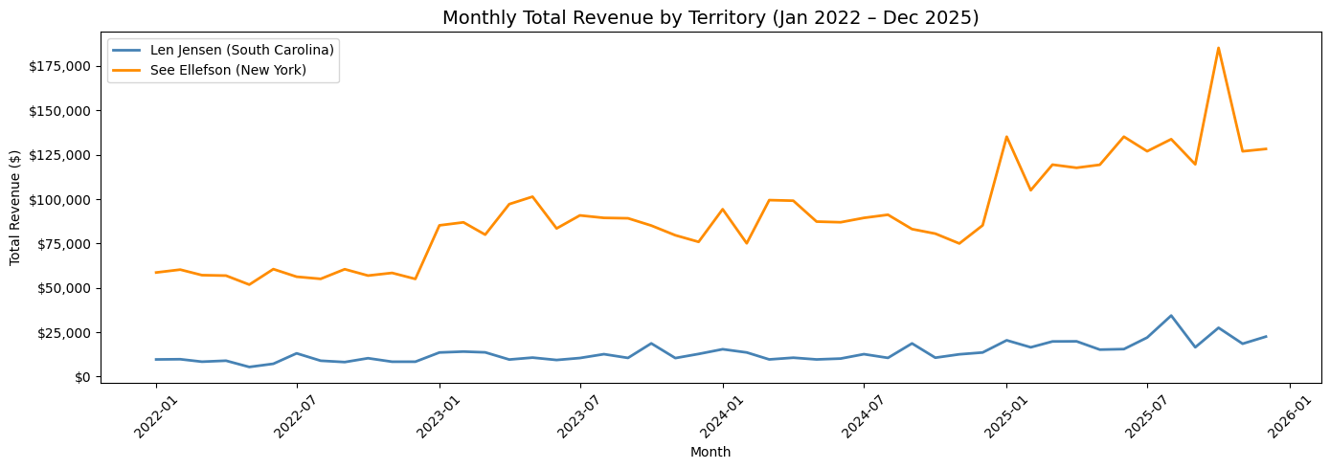
Monthly Revenue Trends
48-month period: January 2022 – December 2025
SC Total Revenue
NY Total Revenue​
Shared Worst Month
$13,517
$90,225
May 2022 ​
2 stores · Best: Aug 2025
Both territories declined
12 stores · Best: Oct 2025​

Slide 4
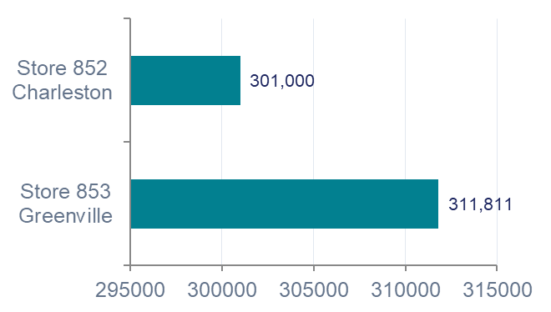
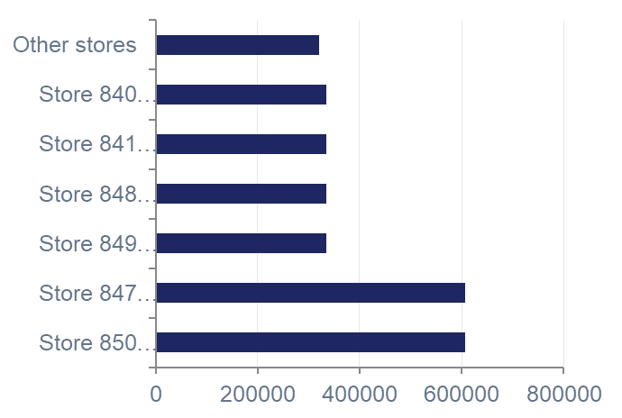
Store Performance Rankings
South Carolina
New York

Slide 5
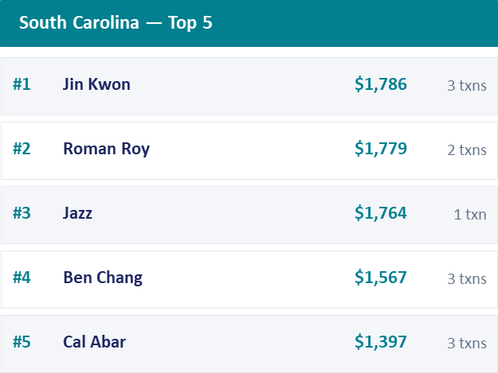
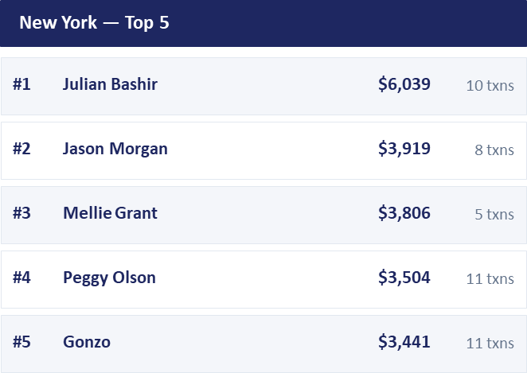
Top Customers by Territory

Slide 6
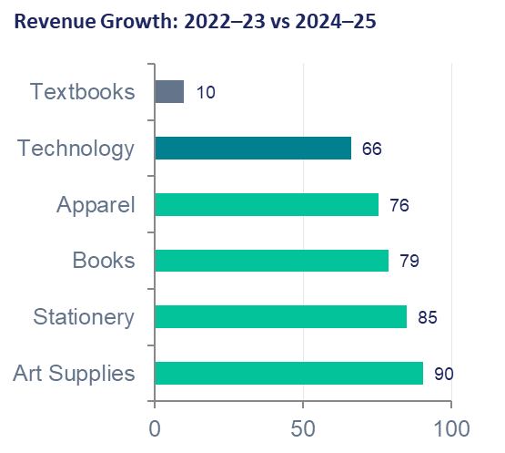
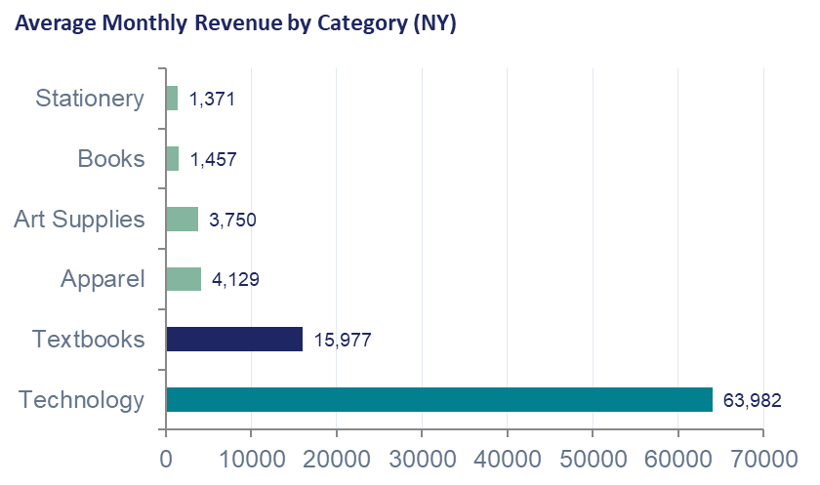
Product Category Analysis

Slide 7
Marketing Recommendations
Prioritize Art Supplies & Books
Fastest-growing categories (+ 90%). Low current revenue means significant room to expand with targeted promotions & various discounts.
Capitalize on Textbook Seasonally
Launch back-to-school campaigns in late July-August & again in January. Bundle with Stationary to increase average order value during peak demand.
Grow Rewards Enrollment in South Carolina
Only 10% of SC transactions are linked to a rewards ID therefore sign-up incentives would unlock personalized marketing.

Slide 8
Thank you!
Vesna cari vesnacari27-collab/Capstone_2

